Slide 1
CARDS 201: Information Forms and Claims Activity Reports
CARDS Enhancements 2025
State of Nevada Workers’ Compensation Section (WCS)

Slide 2
CARDS 201: Information Forms and Claims Activity Reports
TRAINING MODULE
Supporting the CARDS 2025 Enhancements Release

Slide 3
Overview
Objectives
Training Course: CARDS 201: Information Forms and Claims Activity Reports
Audience: Insurer and TPA CARDS Users
Prerequisites: CARDS 101: Introduction to CARDS
Course Length: 1 hour
At the completion of this course, training participants will be able to complete and update the Information Form, understand how to set related permissions, and access the Claims Activity Report.

Slide 4
Modules
Information Forms
TPA Linking and Permissions
Claims Activity Report

Slide 5
Insurer and TPA Information Forms
UPDATING CONTACT INFORMATION IN THE CARDS APPLICATION
Notes:
To include the purpose of the insurer and TPA info forms, how to complete the form, update it, etc. Scenario where multiple people may need to go in and fill out their contact information

Slide 6
Insurer and TPA Information Forms
Objectives
Insurer Information Form
TPA Information Form
At the completion of this module, training participants will be able to submit and update contact information for insurer and TPA entities.
Notes:
TIP: Use this slide as the 2nd slide in each Module deck. If the module is broken down into sub-sections, then use this slide after each Section Divider.

Slide 7
Information Forms
MAINTAINING CONTACT INFORMATION IN CARDS
The information forms are an efficient method of collecting necessary contact information from insurers and TPAs. This form must be updated on an annual basis. Entities that do not comply could become eligible for a fine.
The following contacts may be included on the form:
CONTACT | GROUP
In-State Physical Office Location | Insurers & TPAs
Corporate Contact | Insurers
Compliance Manager | Insurers & TPAs
Coverage Verification Contact | Insurers
Statutory Reporting Contact | Insurers
Proof of Coverage Contact | Insurers
Location of Claim Records | Insurers & TPAs
WC Safety Fund Assessment Contact | Insurers
Receipt of Claim Documentation | Insurers & TPAs

Slide 8
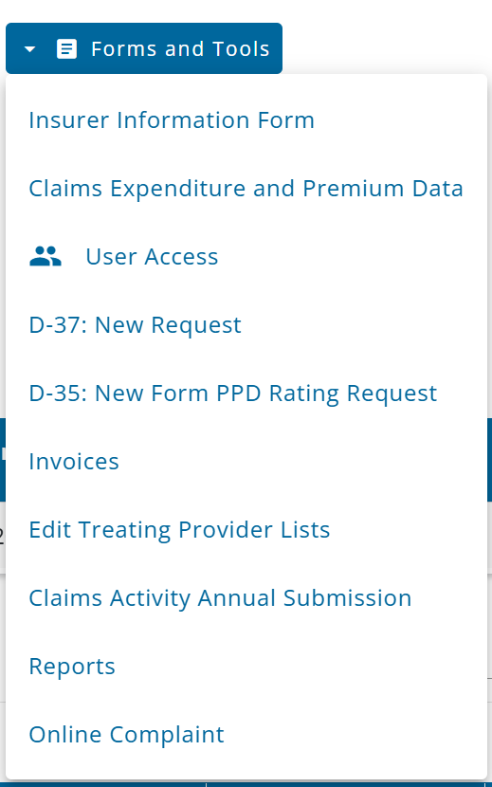
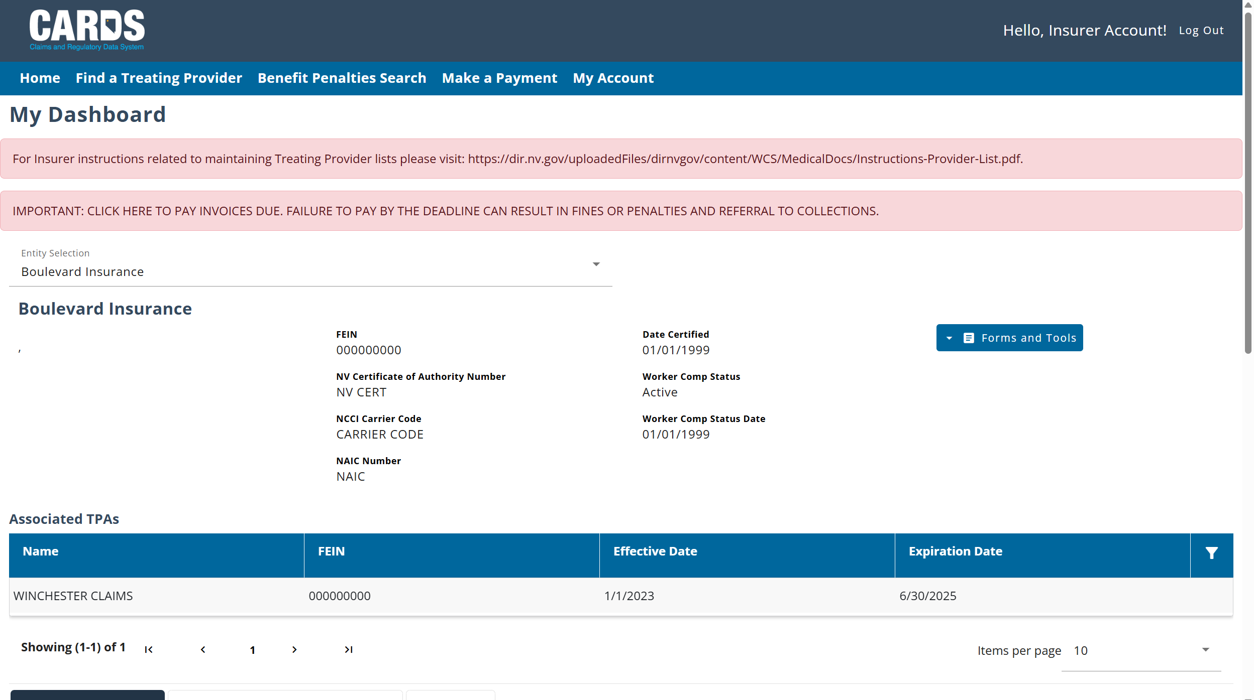
Navigating to the Information Form
The information form is accessible from the Forms and Tools menu for users with permissions.
Notes:
Note: All of the attendees should have knowledge of how permissions can be set by admin users, but you may want to verbalize the process quickly here as a refresher.

Slide 9
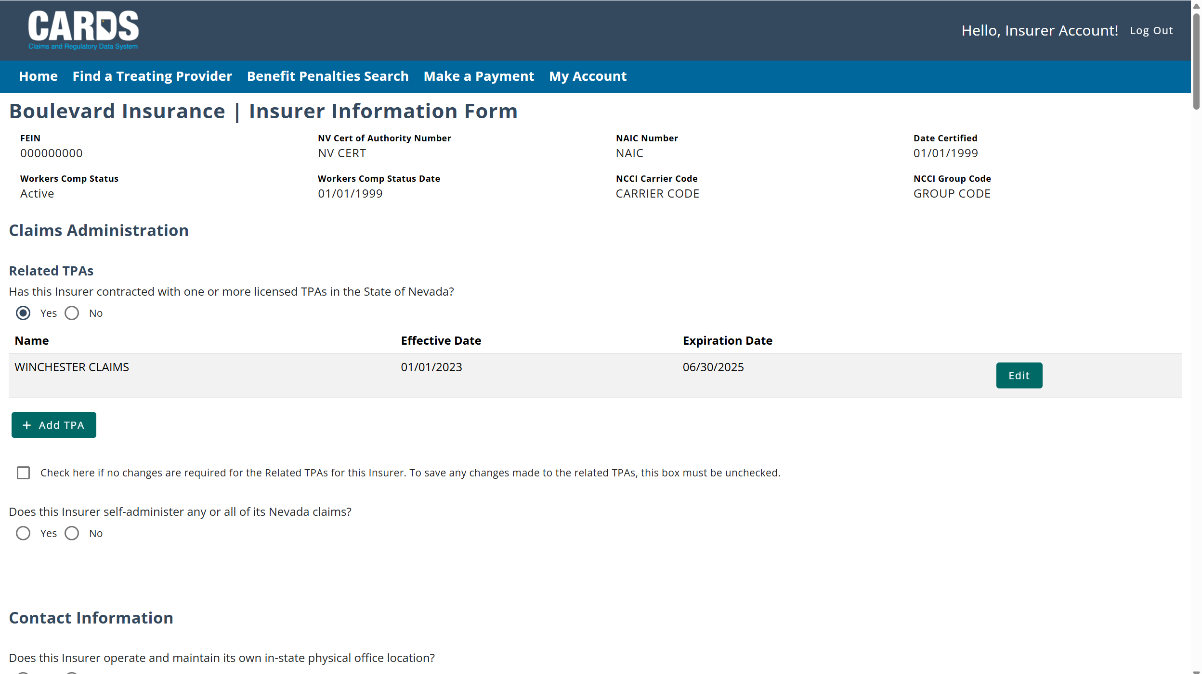
Insurer Information Form
Note: The information form will be prepopulated with any information that is already on file.
Notes:
Note: The TPA information form is very similar to the insurer information form. The primary difference is that the TPA information form does not include the Claims Administration section

Slide 10
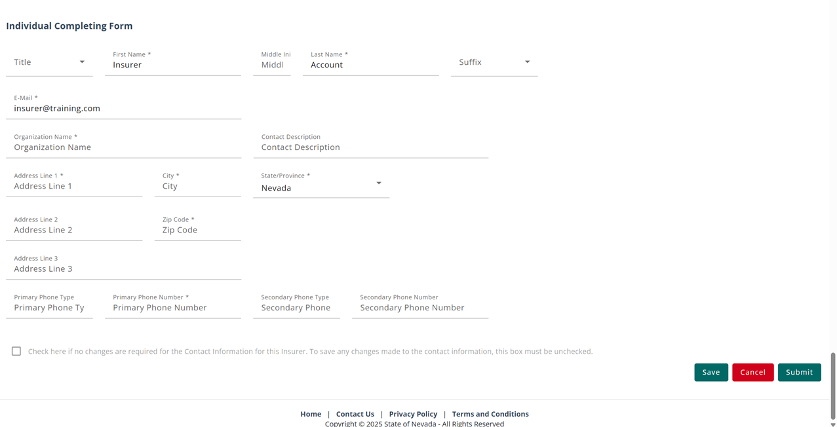
Insurer Information Form
Save: If you wish to save a draft and come back to it later
Cancel: If you no longer need to submit a form. Your
progress will not be saved
Submit: Ensures that the completed form has been
submitted

Slide 11
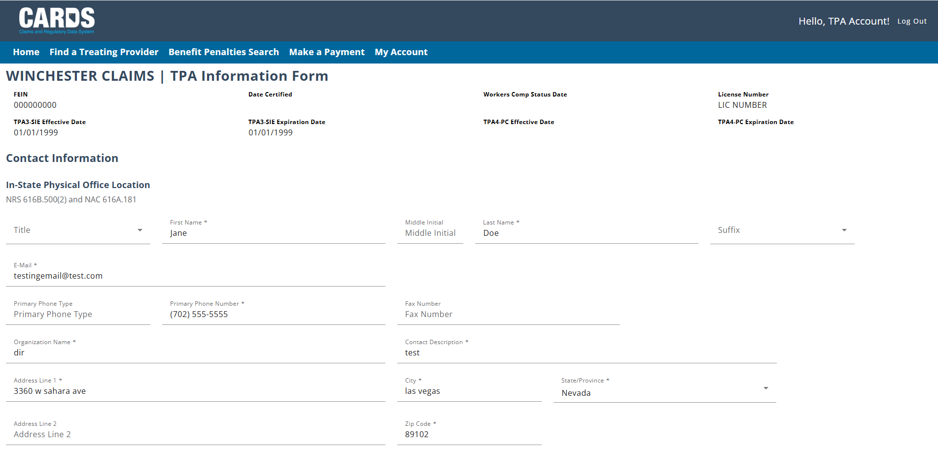
TPA Information Form
Note: The TPA Information Form process is similar to the Insurer Information Webform. However, it will collect additional information related to the Annual Request for Claims Handled data and List of Accounts .
Notes:
Note: The TPA information form is very similar to the insurer information form. The primary difference is that the TPA information form does not include the Claims Administration section

Slide 12
Claims Handled and List of Accounts
Once a year, between January 15th and March 1st, TPAs will be required to submit data related to the total number of workers’ compensation claims that were handled by the TPA and upload a list of the clients for whom the TPA administered workers’ compensation claims for. The data submitted will based on the previous fiscal year.
If the data has already been submitted for a given year, the user will have the ability to select that they are only updating the contact information and will not be required to submit the additional information on the form.
Notes:
Note: The TPA information form is very similar to the insurer information form. The primary difference is that the TPA information form does not include the Claims Administration section

Slide 13
Viewing the Submitted Information Form
The submitted information form can be viewed from the Filing History tab. If you have saved a draft, you can also find and reopen it from here. Once the information form has been submitted, it cannot be edited, and a new information form must be initiated to update any fields.
Notes:
Note: As you are showing this slide, this would be a good place to also explain a bit about using the filter functionality to find a filing. Most of the insurers and TPAs will end up having a large volume of filings and using the filter will save time when looking for a specific record.

Slide 14
TPA Linking and Permissions
MANAGING USER ACCESS FOR INSURERS AND TPAS
Notes:
To include how to link TPAs to insurers, how admin users can update TPA permissions and permissions for other insurer users including to be able to access the insurer information form and the claims activity report

Slide 15
TPA Linking and Permissions
Objectives
Linking a TPA to an insurer
Setting permissions for insurer users
Setting permissions for TPA users
At the completion of this module, training participants will be able to link a TPA to an insurer entity and set permissions for individual user accounts.
Notes:
TIP: Use this slide as the 2nd slide in each Module deck. If the module is broken down into sub-sections, then use this slide after each Section Divider.

Slide 16
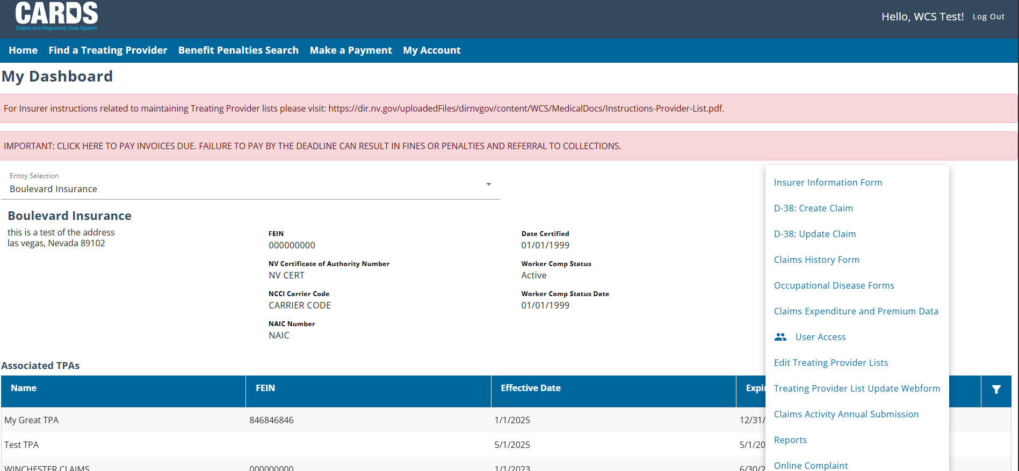
TPA Linking
TPA’s will be linked to an Insurer account using the Insurer Information Webform. If an Insurer has an active relationship with a TPA, external users who belong to the TPA can be added as authorized users on the Insurer group. To know which TPAs are linked to your Insurer group, Insurer admins will need to navigate to the User Access page.
Notes:
Note: Most of the user management access pages are currently not appropriate to show in their entirety as they contain active personal email addresses. Trainers may verbally elaborate on the User Access Management page as well as refer to the CARDS 101 training for additional information.

Slide 17
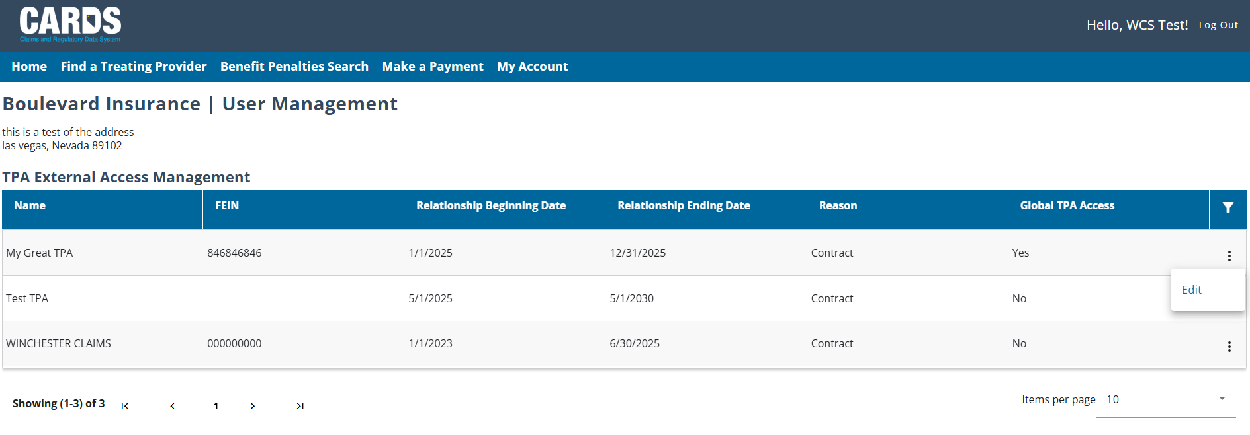
Adding Global TPA Access
Once an insurer Admin has navigated to the User Access Management page, the list of TPAs will display under the TPA External Access Management section, where you can update the Global TPA Access.
Ellipsis provides the edit option
Notes:
Note: Most of the user management access pages are currently not appropriate to show in their entirety as they contain active personal email addresses. Trainers may verbally elaborate on the User Access Management page as well as refer to the CARDS 101 training for additional information.

Slide 18
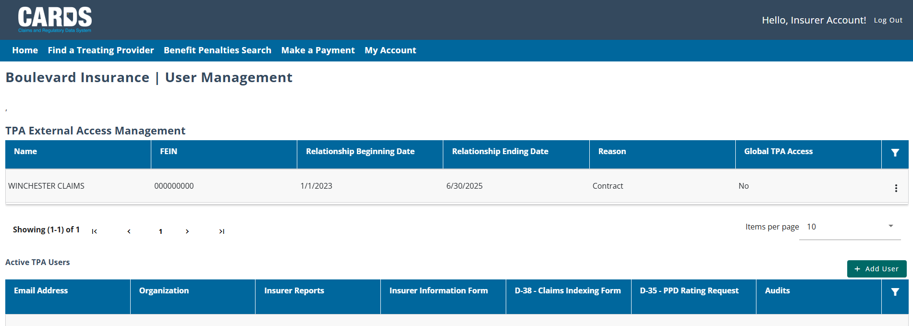
Adding a TPA User
Insurer Admin continuing to navigate the User Access Management page, can begin the process of adding an additional TPA user by clicking the button at the top right corner of the Active TPA Users section.

Slide 19
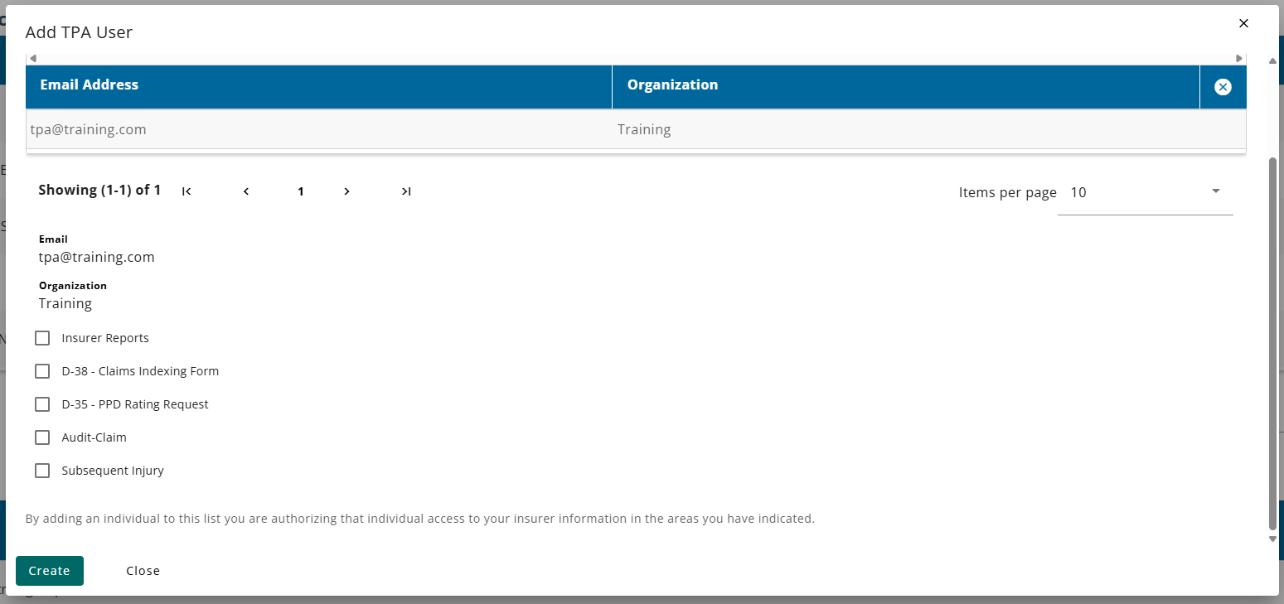
Adding a TPA User
TPA users that belong to the related TPA groups can be selected as authorized users by the Insurer group. Once the insurer admin has selected the user, the available permissions can be provided.
Notes:
Note: Most of the user management access pages are currently not appropriate to show in their entirety as they contain active personal email addresses. Trainers may verbally elaborate on the User Access Management page as well as refer to the CARDS 101 training for additional information.

Slide 20
Adding Insurer Users
The Insurer Admin continuing to navigate the User Access Management page, will also have to add Insurer Users by clicking the button at the top right corner of the Individual External Access Management section.

Slide 21
Setting Permissions
Once the Add User button is clicked, The insurer admin can enter information for the new user and select the permissions they wish to provide.
Notes:
Note: Most of the user management access pages are currently not appropriate to show in their entirety as they contain active personal email addresses. Trainers may verbally elaborate on the User Access Management page as well as refer to the CARDS 101 training for additional information.

Slide 22
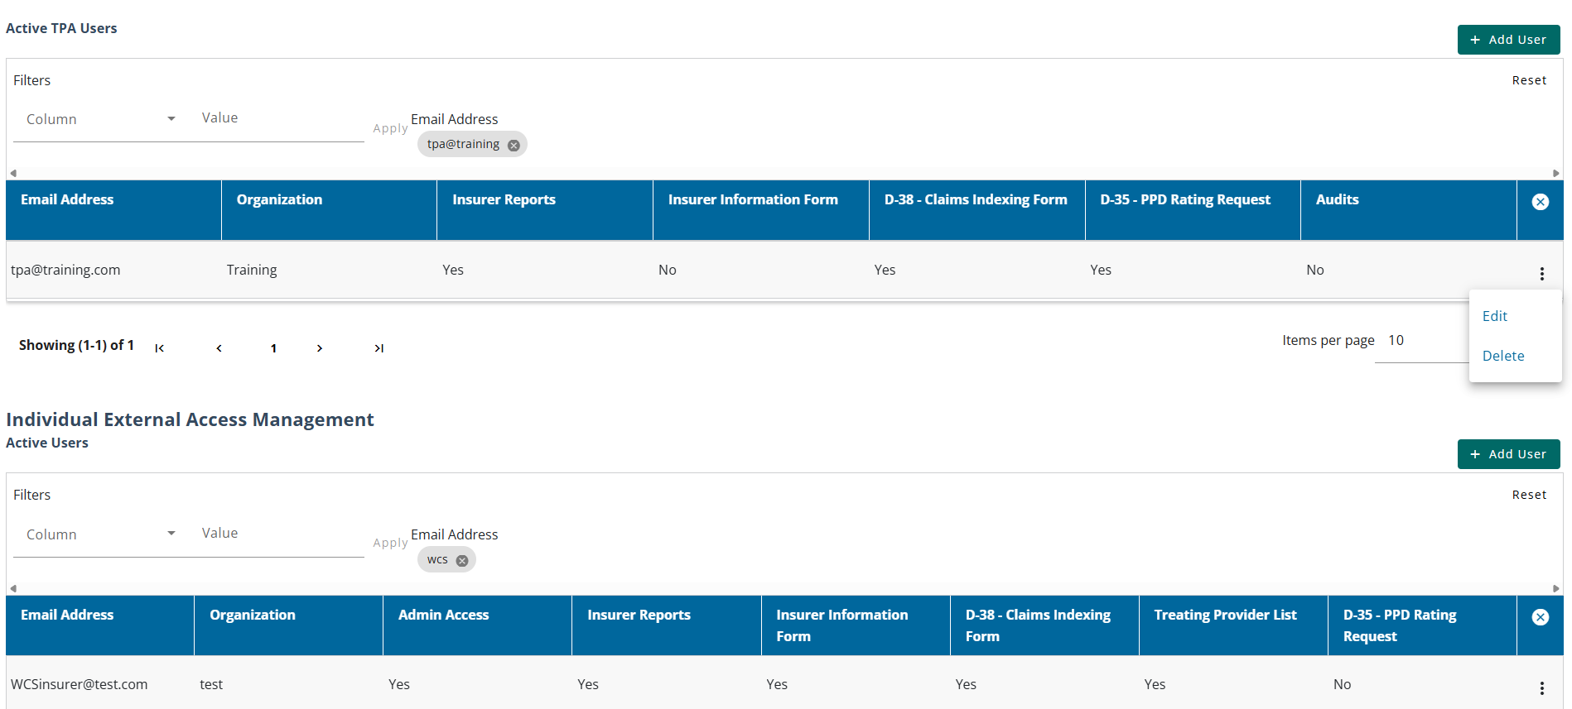
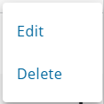
Managing User Permissions
Once a user has been added, permissions can be updated using the Edit feature. Using the Delete feature, the user will be removed from the entity.
Ellipsis provides the edit options and/or delete users

Slide 23
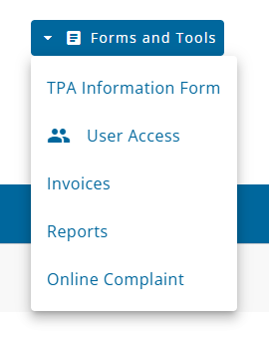
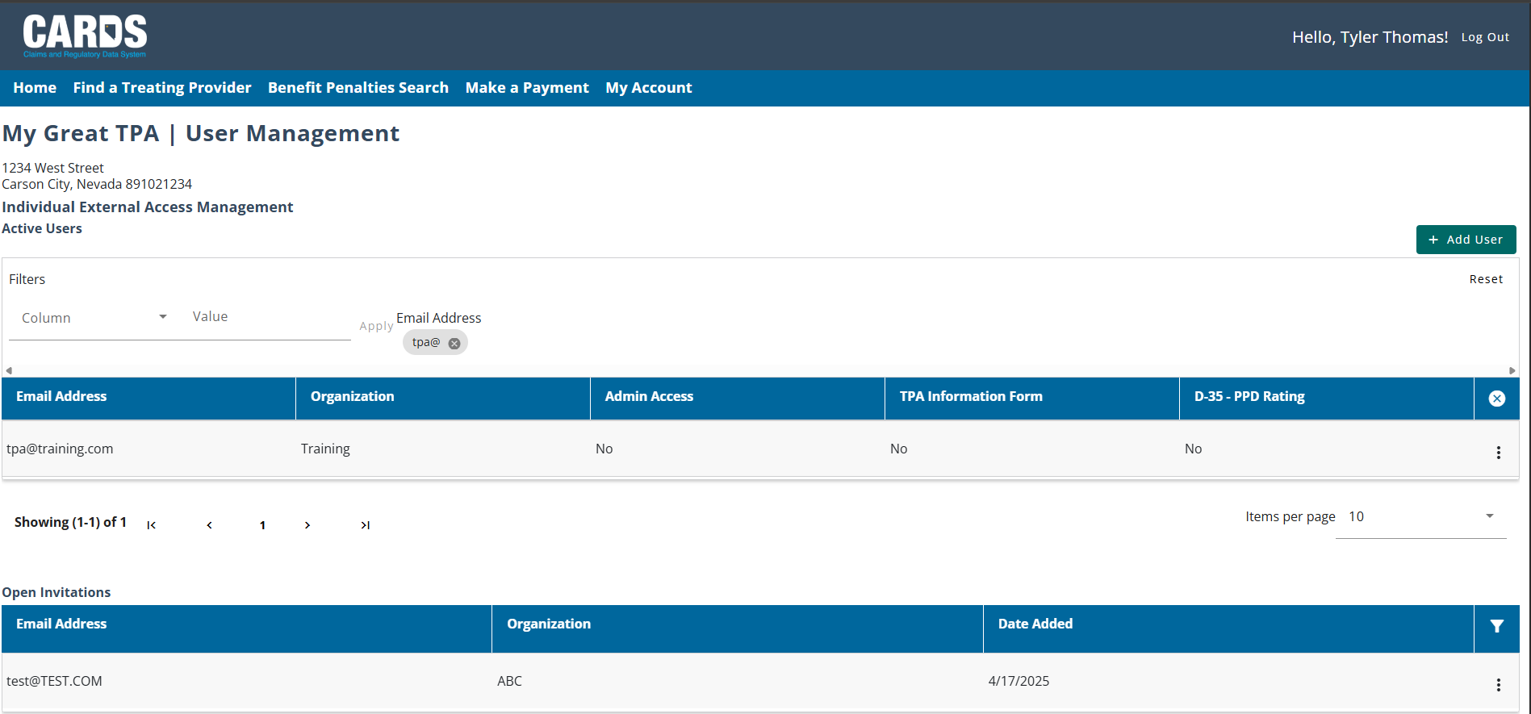
TPA User View

Slide 24
Claims Activity Report
ANNUAL FILING REQUIREMENT
Notes:
How to access and complete the claims activity report webform, scenario in which form is needed to be filed, viewing the filing, etc.

Slide 25
Claims Activity Report
Objectives
Claims Activity Report overview
Navigation and Submission
At the completion of this module, training participants will understand how to file their annual Claims Activity Report.
Notes:
TIP: Use this slide as the 2nd slide in each Module deck. If the module is broken down into sub-sections, then use this slide after each Section Divider.

Slide 26
Claims Activity Report
REPORTING ALL CLAIMS FOR THE YEAR
The Claims Activity Report must be submitted annually by each insurer entity. For insurers with related TPAs, the TPAs will send their data to the insurer to submit. The submission window is open from July 15th through September 1st each year. Users who do not submit the data within the allotted timeframe can become eligible for fines.
Insurers can elect to report no claims activity for the previous fiscal year. If there was claims activity for the fiscal year, the webform includes six parts as follows:
Part 1 – Claims Information
Part 2 – Compensation Expenditures
Part 3 – Medical Expenditures
Part 4- Rehabilitation Expenditures
Part 5 – Recoveries
Part 6 – Summary
Notes:
Note: Be sure to specify that this is one submission per entity and not per account. Also note that although the submission window is only open from July through September, the form is available on CARDS year-round.

Slide 27
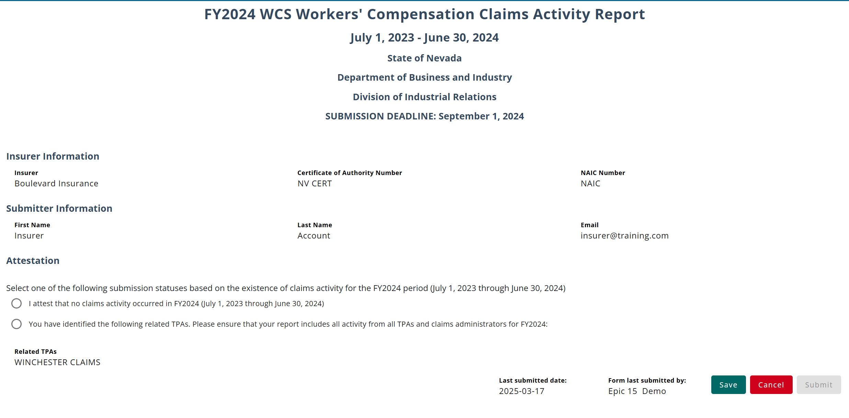
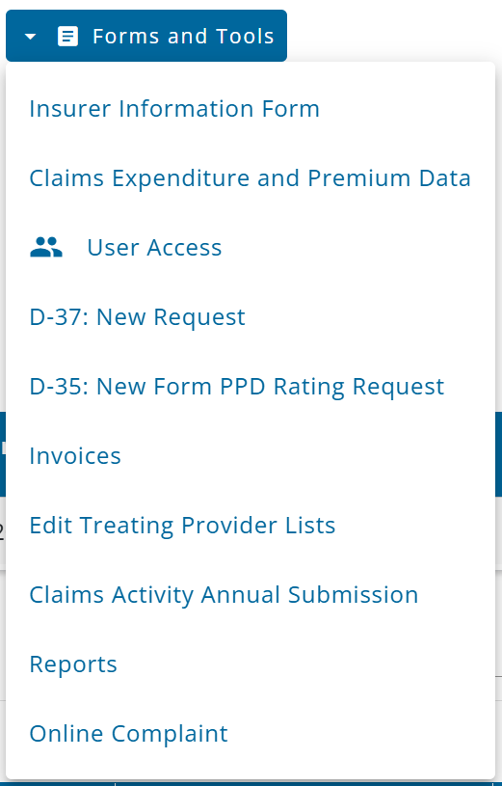
Navigating to the Claims Activity Report Webform
The Claims Activity Report webform is available through the Forms and Tools menu for insurers only. Only users who have been granted access by their admin user will be able to see the option.

Slide 28
Reporting No Claims Activity
If there is no activity to report for the previous fiscal year, the user can attest to the Insurer having no claims activity and continue with submitting the webform.

Slide 29
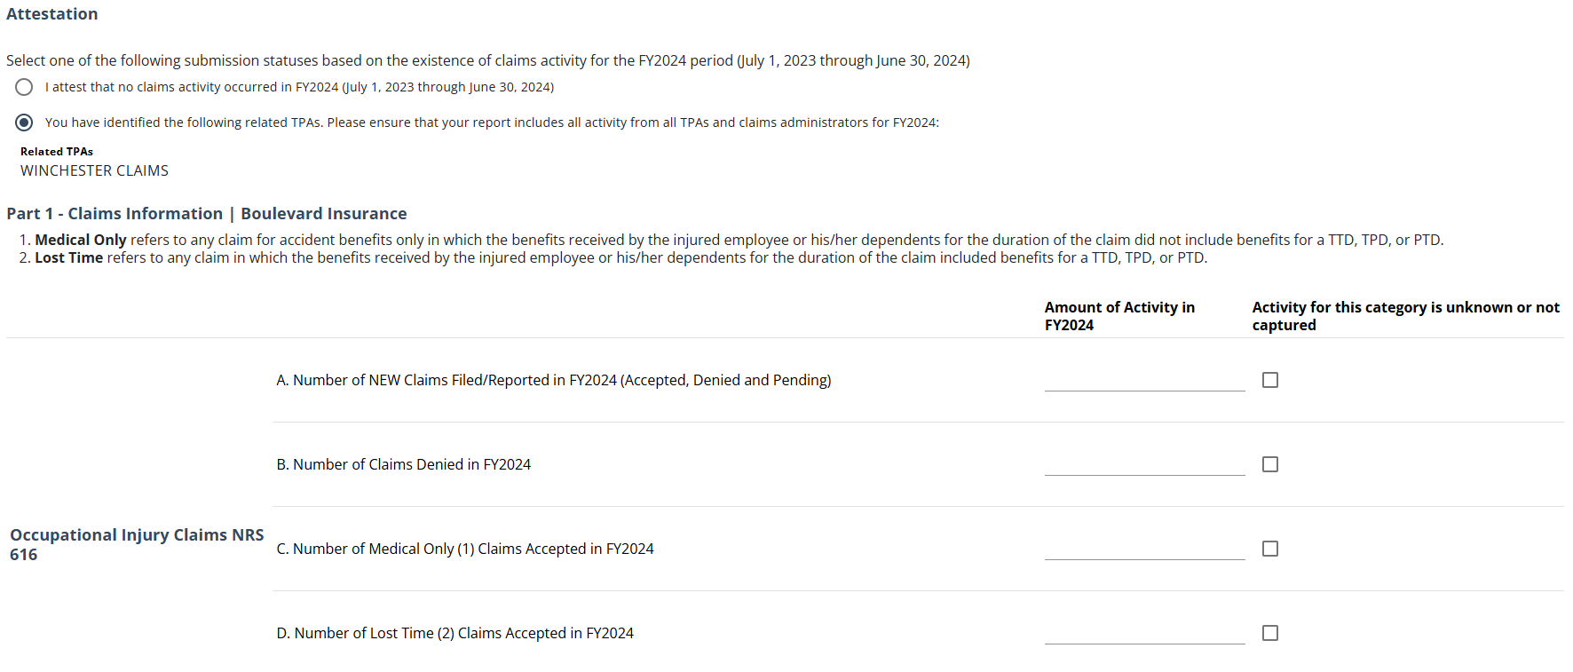
Completing the Claims Activity Webform
If there is activity to report for the fiscal year, once the Insurer selects the other option in the Attestation section, the rest of the form will populate, and each field must either have a value entered or be marked as “Activity for the category is unknown or not captured”.

Slide 30
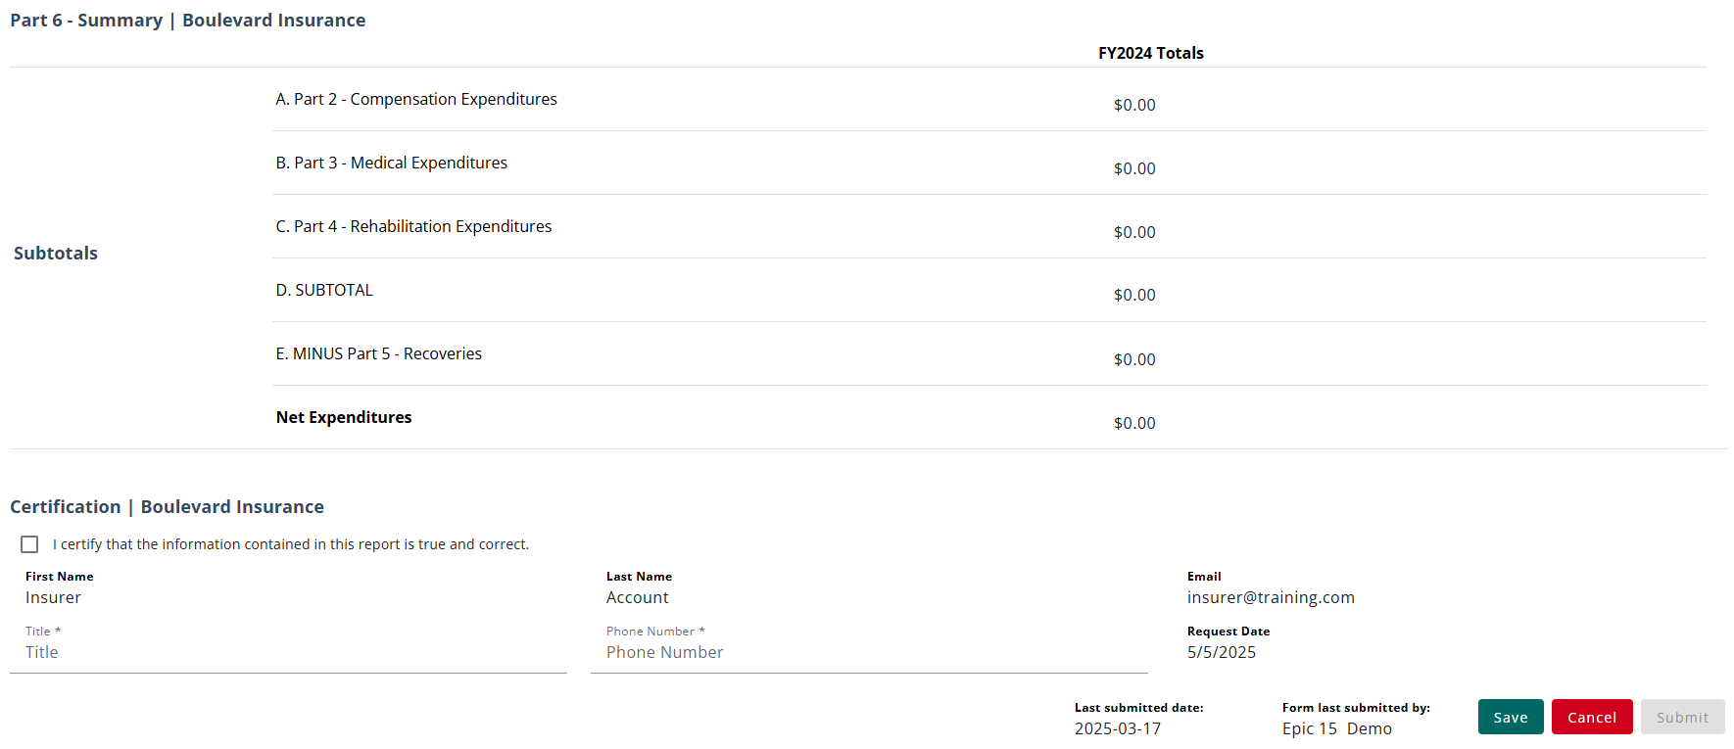
Summary Section
After completing Parts 1 through 5 of the webform, the values in each section will be summarized in Part 6 – Summary for a final review before submitting the webform.

Slide 31
Submitting the Claims Activity Report Webform
After the webform has been submitted or saved, it can be viewed in the Filing History tab.
Notes:
Note: The form can be updated through 12/31 of the current year after submitting.

Slide 32
Questions?
CARDS 201: INFORMATION FORMS AND CLAIMS ACTIVITY REPORTS
For any questions after this presentation, reach out to CARDS@dir.nv.gov
Notes:
Note: Replace the date placeholder with the date of the presentation to stakeholders and update contact information as necessary

